Slide 1
Web Technology
Part 6:
JavaScript Language – p.4
AngularJS - 1

Slide 2
What is AngularJS
Developed by Google
Active project with large eco-system
Supports modern browsers
A JavaScript framework for creating dynamic web applications
Open Source
GitHub: https://github.com/angular/angular.js
MIT License
Uses jQuery
jQuery 1.7.1 or above
jQLite

Slide 3
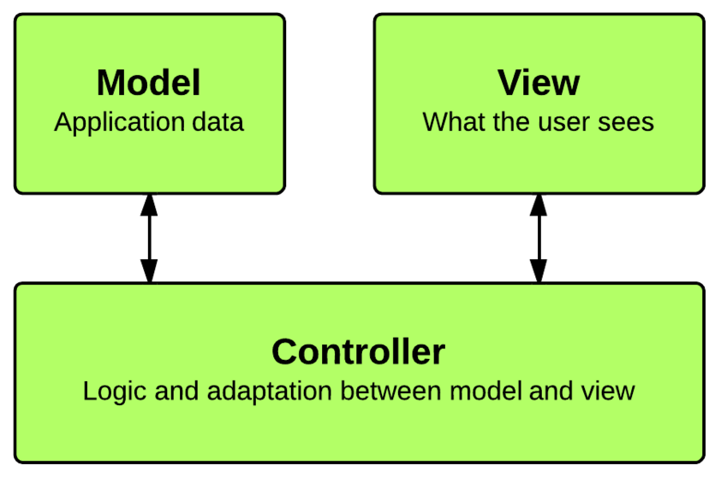
MVC
Model
The data
Controller
The behavior
Modifying / updating the models
View
The interface
How the data is presented to the user
JavaScript
HTML

Slide 4
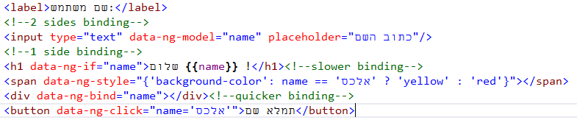
Directive, Expression
Directives are markers on a DOM element that tell AngularJS's HTML compiler to attach a specified behaviour to that DOM element:
Attribute
Element name
Comment
CSS class
directives.htm
Angular Expressions:
1+1
a/b
user.name
Items[i]

Slide 5
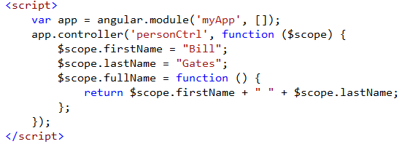
Controllers
Angular controllers - regular JS Objects controlling the data of AngularJS applications
Embedded
Or
External
directives.htm
controller_emb.htm
controller_ext.htm

Slide 6
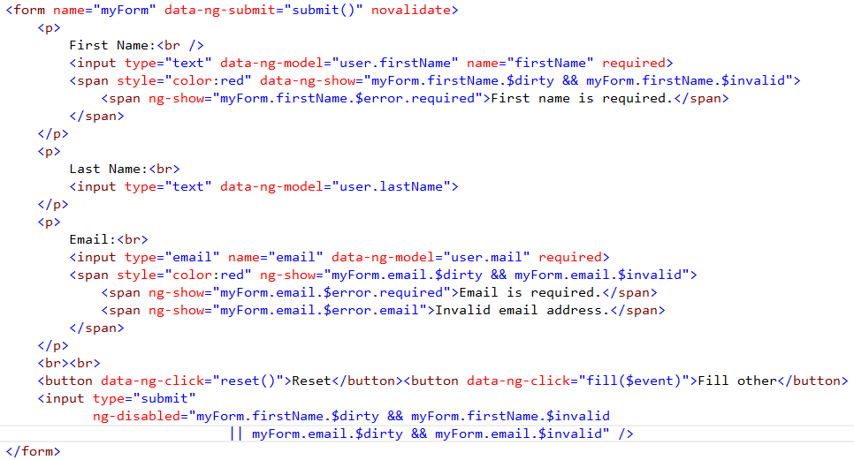
Form
Form is a collection of input controls
$pristine: TRUE, if the user has not interacted with the form yet
$dirty: TRUE, if the user has already interacted with the form.
$valid: TRUE, if all containing form and controls are valid
$invalid: TRUE, if at least one containing form and control is invalid.
$error: Is an object hash, containing references to all invalid controls or forms, where:
keys are validation tokens (error names)
values are arrays of controls or forms that are invalid with given error.
forms.htm
In CSS:
ng-pristine
ng-dirty
ng-valid
ng-invalid
.ng-dirty{ background-color: yellow; }

Slide 7
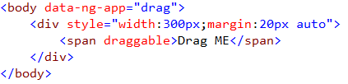
Compiler
Compiler is an Angular service which traverses the DOM looking for attributes.
Compile: traverse the DOM and collect all of the directives. The result is a linking function.
Link: combine the directives with a scope and produce a live view.
compilers.htm

Slide 8
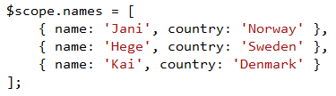
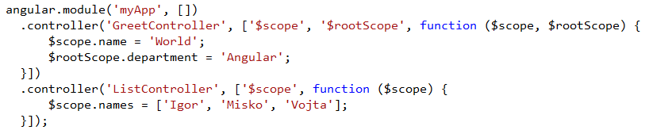
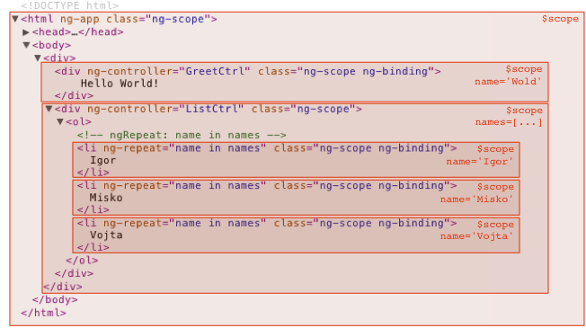
Scope
Scope is an object that refers to the application model
Data-Model
Hierarchies
API
$watch - to observe model mutations
$apply - to propagate any model changes
controller_ext.htm
scope.htm

Slide 9
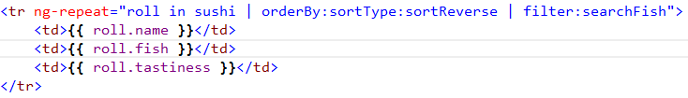
Repeat
The ng-repeat directive instantiates a template once per item from a collection
Iterating over object properties
Iterating over array elements, tracking
Sorting and Filtering
repeat.htm

Slide 10
More
You can do a lot more with AngularJS
Custom directives
http://docs.angularjs.org/guide/directive
Filters
http://docs.angularjs.org/guide/dev_guide.templates.filters
To learn more:
Tutorial: http://docs.angularjs.org/tutorial
Documentation: http://docs.angularjs.org/guide/overview

